Slide 1
Solving Linear Inequalities
EQ – How do I solve linear inequalities and represent solutions on a number line?

Slide 2
Learning Objectives
Solving linear in equalities
Representing inequalities on a number

Slide 3

Solving Linear Inequalities EQ – How do I solve linear inequalities and represent solutions on a number line?
Task:
Solve $5x + 7 = 3x−5$
Find the volume of the cone
Simplify $\sqrt{8}+3\sqrt{2}$
Write a value for $x$ where $x>4$
13m
10m

Slide 4
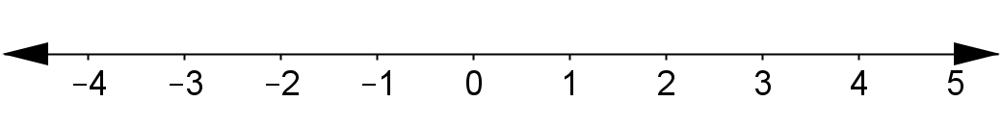
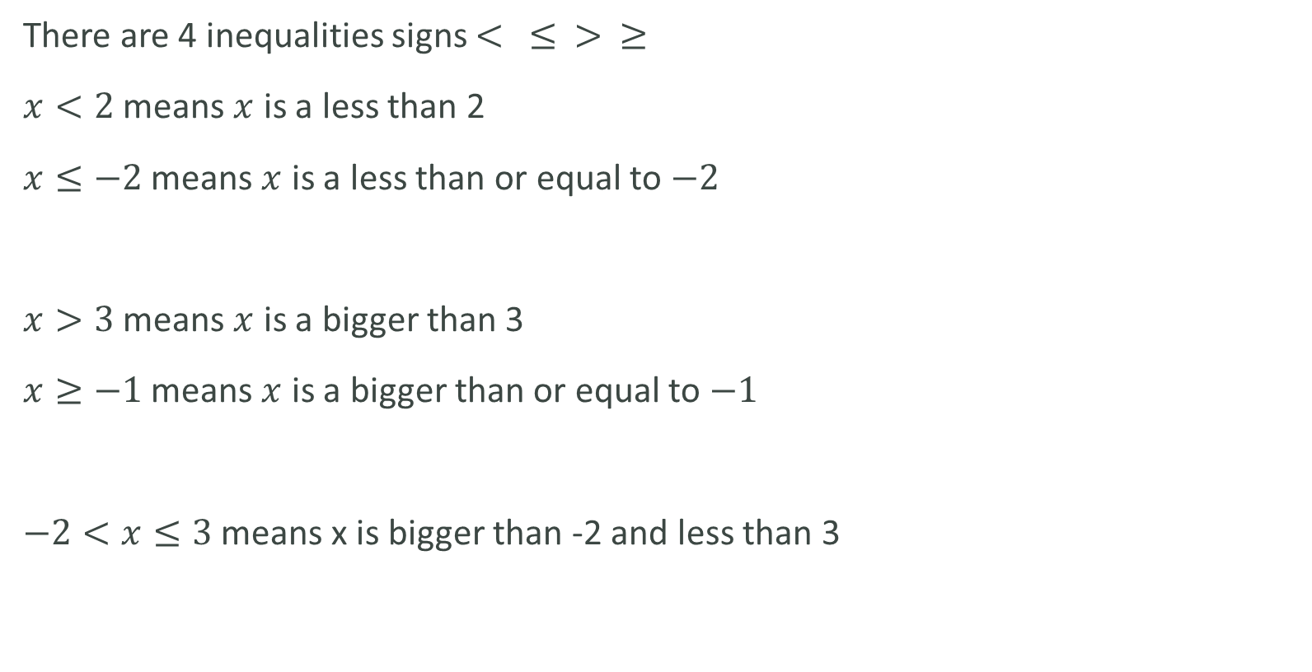
Solving Linear Inequalities EQ – How do I solve linear inequalities and represent solutions on a number line?
Writing
There are 4 inequalities signs $< ≤ > ≥$
$x<2$ means $x$ is a less than 2
$x≤−2$ means $x$ is a less than or equal to $−2$
$x>3$ means $x$ is a bigger than 3
$x≥−1$ means $x$ is a bigger than or equal to $−1$
$−2<x≤3$ means x is bigger than -2 and less than 3

Slide 5
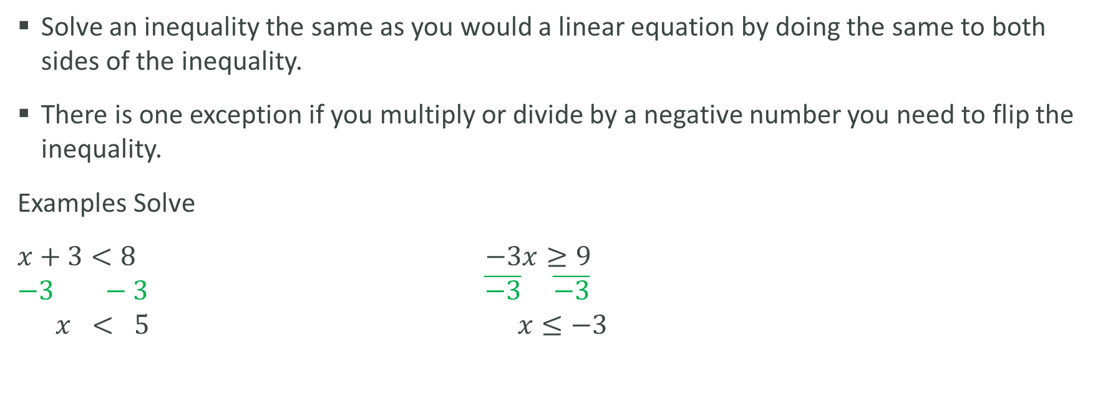
Solving Linear Inequalities EQ – How do I solve linear inequalities and represent solutions on a number line?
Writing
Solve an inequality the same as you would a linear equation by doing the same to both sides of the inequality.
There is one exception if you multiply or divide by a negative number you need to flip the inequality.
Examples Solve
$x+3<8$ $−3x≥9$
$$−3 −3 \overline{−3} \overline{−3}$$
$$x < 5 x≤−3$$

